Slide 1
Speech to Sign language translation for E-learning
Team Guide : Dr. Amit Mishra
Team Members :
Prachi Bhatt (19BAI10111)
Toshini Agrawal (19BAI10115)
Shivangi Singh (19BAI10097)
Notes:
s

Slide 2
INTRODUCTION
Since the COVID -19 pandemic has disrupted the conventional life style of individuals across the world, the virtual world has come to the rescue. Amongst several educational establishments faculties have shifted their base to virtual platforms to conduct classes online. But there are many students around the globe who struggle to attend their online classes properly because of reasons like internet connectivity issue, not having proper devices, not having proper place to study etc..
But there are people who struggle to understand what’s being taught in the virtual classes because of certain sensory,cognitive or functional disabilities.
Specifically, individuals with hearing impairments, with partial or complete loss of hearing are prevented from participating in live (synchronous) cooperative e-learning activities, because of the common reliance on voice communication in such activities. whereas speech-to-text systems offer an eventual pathway for the Deaf individuals to follow the communication, it doesn't enable them to participate within the same mode. Not all deaf individuals have the same communication skills: some people communicate using oral language and/or writing and lip-reading, whereas others use Sign Language. Some are bilingual deaf people that use both kinds of communication.
Notes:
1. WHY ISL - no other SL like ASL, BSL(diversity factor)
2. STATISTICS – increase in deaf community members with time.
3. ROLE of ISL.
4. Role and significance of technology for communication and learning among Deaf Community.
5. General methodology of proposed system.

Slide 3
Nowadays, to make video streaming on the internet more accessible for everyone, people are using different ways to achieve this, such as adding captions in videos, including audio description or adding transcript to videos which are helpful for people with hearing impairment. We want to make streaming videos a bit more accessible for everyone by using our app.
In our app we are going to use Sign language to help people with hearing impairment. Our app takes audio as an input and converts it into Indian Sign Language. With our app we hope to make virtual world a better facility for the hearing impaired individuals . Our app aims to get rid of communication barriers by creating the audio track content from online videos obtainable to hearing-impaired people by mechanically generating a video-based speech to signing translation.
Our app will be easy to use and easily accessible for everyone.
Notes:
s

Slide 4
Existing work with limitations
In India, there are no app that converts audio to Indian Sign Language.
There are a lot of apps available that teach Indian Sign Language but they do not convert audio to Indian Sign Language.
The existing apps don’t convert audio to Sign language real time, they convert one sentence at a time.
Our app will be ad-free.
“Hello”
Notes:
s

Slide 5
About our framework:-
User’s Video
Our app works in split screen mode.
As shown in the figure, the above part is the user’s video (for eg: online lectures) and below it is our app which is translating the audio from the video to ISL in real time.
App translating the video’s audio to ISL in real time
Split Screen on phone
Notes:
s

Slide 6
Proposed work
Logo page
Login page
Pop outs of App permissions
Welcome page {welcome phrase.}
Directions to use split screen mode in android
Video lecture
Split screen view
Indian sign language (2 hands)
Notes:
p

Slide 7

Methodology
Audio (input) as dataset
Recognition(the technology needed to capture and interpret audio)
Synchronous translation
(LSTM)-(speech-to-sign language)
Representation(Animated hands interpreting audio)
Notes:
p

Slide 8
Continue…..
Speech-to-Sign Language Translation
Recognition
(to capture and interpret data)
Audio (input) as dataset
Synchronous translation
Representation
Animated hands gestures (ISL)
Data Selection
Pre -processing
Transformation
Deep learning algorithm
Deep learning algorithm
Notes:
p

Slide 9
Continue…..
Here are some important considerations while choosing an algorithm.
Size of training data -choosing the algorithms with high bias /low variance depending on size of dataset.
Accuracy and Interpretability of output
Speed or training time-algorithms which should be easy to implement and quick to respond.
Linearity-prioritise linear data but if not then algorithms who can handle complex data without providing high residual errors.
Number of features:- choosing algorithm which can reduce dimensionality and select important features.
Notes:
p

Slide 10
Novelty of the project
It implements Speech-to-sign language translation for e-learning using Indian Sign Language .
Synchronous translation of live lectures from speech to indian sign language
Our App is free which does not contain premium packages which are very costly for users to afford.​
Notes:
t

Slide 11
Real time usage
This system is designed notably for deaf people for the purpose of educational objectives(e - learning).
The high level of visualisation allows the user to be able to interpret the video lecture(audio) logic seeing animated hands.
The synchronous translation of the app makes the user to understand the lecture without any lagging between animated hands and audio.
Notes:
t

Slide 12
Software requirements (for user)
•Processor:
Minimum 1 GHz; Recommended 2 GHz or more​
•Ethernet connect strongly action (LAN) OR a wireless adapter (Wi-Fi)​
•Hard Drive:
Minimum 32 GB; Recommended 64 GB or more​
•Memory (RAM):
Minimum 1 GB; Recommended 4 GB or above​
•Sound card w/speakers​
Notes:
t

Slide 13
Hardware and Software requirements (for developer
Hardware Requirements:​
It is highly recommend to use at least 4 GB ram or higher.
better processor like i5 or i7.​
GPU for training the deep learning models efficiently.
And last, if you have a good android device​(8+) or iOS(10+) for testing and debugging.
Notes:
t

Slide 14
Software Requirements : (for developer)
FRONTEND-
java SDK and ândroid studio IDE (with SDK bundle)
Visual Studio Code.
BACKEND-
Python 3.8.x or latest is preferred.
Browser supporting Javascript Web Speech API
Tensorflow workstation or Opencv
pyAudio
MongoDB
Blender 3D tool
Notes:
t

Slide 15
TECHNICAL REQUIREMENTS
An important challenge of the project is to achieve a minimum level of quality of the technology, because the usability of the developed systems will depend on that quality. The following technologic requirements are defined:
─ Speech recognition system will demand a recognition rate higher than 90% in the selected application domain. If that rate is not reached with speaker-independent models, an adaptation process will be performed to each speaker involved in the evaluation in order to guarantee that rate.
─ It is also necessary a translation rate higher than 90% for the application domains targeted in the project. In order to obtain that translation rate, several translation strategies will be analyzed and combined.
Notes:
s

Slide 16
Continue…….
Finally, it is necessary an intelligibility of the avatar of 90% when representing the signs: recognition rate of deaf people. In order to obtain this intelligibility, the sign generation uses techniques based on inverse kinematics and semi-automatic movement capture that lets to obtain more realistic movements. This approximation requires more time for the dictionary generation, but it is more realistic.
Notes:
s

Slide 17
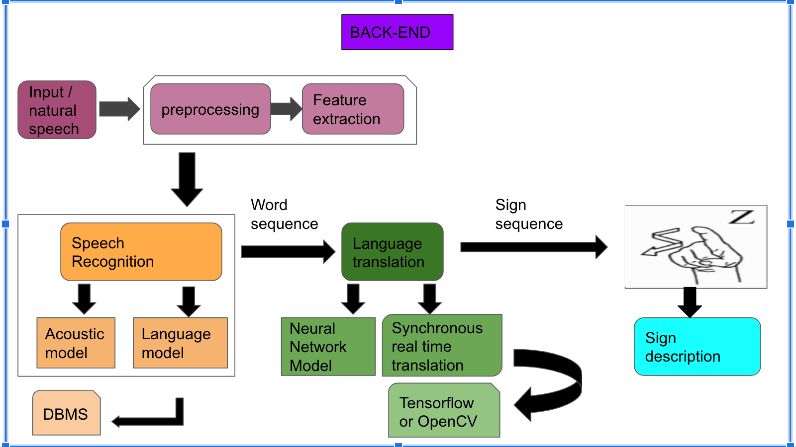
Overall System Architecture and Diagram
FRONT-END
FRONT-END
User
Login page
Welcome page {welcome phrase.}
Pop outs of App permissions
Video lecture
Directions to use split screen mode in android
Split screen view
ISL-hand animation
Notes:
p+t

